Slide 1

Transformational Leadership
What every DevOps leader needs to know
Steve Mayner
SAFe® Senior Program Consultant
Scaled Agile, Inc. steve.mayner@scaledagile.com
November 8, 2016
Notes:
How many

Slide 2
The DevOps Adoption Challenge

Slide 3
Common themes of DevOps adoption
Value streams & organizational design principles/patterns
Leaning out development, reducing batch sizes
Streamline deployment – automated testing, CI, CD, auto deploy
Feedback via telemetry, A/B testing, reviews
Building a learning organization, fast PCDA cycles
Automated change management & environment builds
Integrated security, governance into automation

Slide 4
DevOps patterns in SAFe
Build and maintain a production-equivalent staging environment
Maintain Dev and Test environments to better match production
Deploy to staging every iteration; deploy to production frequently
Put everything under version control
Start creating the ability to automatically build environments
Start automating the actual deployment process

Slide 5
DevOps adoption
-> organizational change
Notes:
How many would agree that transitioning to DevOps and Lean IT leads to organizational change?

Slide 6
Change is hard
Notes:
It’s something we all know, but seeing just how hard change can be in organization after organization that we’ve coached through Agile and DevOps implementations led me to a learning journey that is the reason why Gene invited me to present at this year’s summit. I became fascinated with this with this classic case of an irresistible force and an immovable object… the desperate need to change the way we build, maintain, and enhance our IT systems struggling against this inherent nature we have to resist change.

Slide 7
70% of change initiatives fail
- John Kotter
Kotter, J. P. (1996). Leading change. Boston, MA: Harvard Business School Press.
Notes:
How many of you are familiar with John Kotter’s famous “70% failure rate” in change initiatives? If we believe that DevOps adoption leads to organizational change, then Kotter’s claim should serve as a warning for us that we have to know how to effectively manage organizational change if we want our DevOps implementation to be successful.

Slide 8
Kotter was just the beginning…
“Companies engaging in strategic OC initiatives are more likely to fail than to succeed…”
- Decker, Durand, Mayfield, McCormack, Skinner & Purdue, 2012
“50% failure rate in multiple studies of all types of change initiatives…”
- Shin, Taylor, & Seo, 2012
“70% of all change efforts (in the study) were unsuccessful…”
- Burke, 2011
“41% to 93% failure rate among quality improvement initiatives…”
- Cândido & Santos, 2015
“Initiatives involving culture change have a 19% success rate…”
- Smith, 2002
Notes:
A lot of additional research has reinforced Kotter’s claim. We are also familiar with many very public failures that illustrate just how difficult change can be. (Go through list quickly).

Slide 9
And yet…
Organizations must continously adapt
Notes:
So we know that implementing DevOps and managing the organizational change it brings is challenging… and yet we also know that in today’s environment organizations MUST be able to continuously adapt to survive.
How many of you have read the book Bold? Whether you agree with their call to action or not, what Diamandis and Kotler did a great job of in the first part of their book was to catalog all of the external factors that are literally changing the marketplace in front of our eyes on a daily basis, and the pace of change is accelerating. They talk about advances like artificial intelligence, big data, driverless cars, internet of things, EVERYTHING as a service, breakthroughs in bio science… the list goes on and on. And then last week… how many saw Elon Musk’s announcement regarding solar panel rooftops that look like regular shingles? Caught the entire energy industry by surprise. This is just one example of why organizations have no choice… the ability to change and adapt is now a core competency.

Slide 10

Adapt or die
“Since 2000, 52 percent of the names on the Fortune 500 list are gone, either as a result of mergers, acquisitions or bankruptcies.”
— Teresa Novellino | New York Business Journal
Novellino, 2015
Notes:
The evidence shows that companies who can’t adapt are not going to be around long. This report published last year in the New York Business Journal highlighted the fact that in just 15 years over HALF of the Fortune 500 from the year 2000 are now gone… not just off the list… GONE. That turnover rate in the Fortune 500, S&P, Dow, etc. if you graph it out is accelerating on an exponential curve.

Slide 11
Why does organizational change fail?
Resistance to change
Low readiness for change
Inadequate communications
Poor planning
Lack of training
Institutional inertia (process, structure)
Technology gaps
Lack of organizational alignment
History of change failures
Lack of employee involvement
Bureaucracy, politics, conflict
Poor strategy / wrong change
Unrealistic expectations
Low transparency and trust
- Decker, Durand, Mayfield, McCormack, Skinner & Purdue, 2012
Notes:
So if we know we have to be able to rapidly adapt in our organizations, but that change initiatives frequently fail, where do we go from there? The next step in my journey was to dig into the reasons scholarly researchers found for why change initiatives were failing. This study by Decker et al actually was a study of studies… to survey all of the research at the time to see what patterns they could find. Here are the most frequently cited reasons for change failure… see if any of these look familiar. (Go through list quickly).
That brings us back to our Captain Obvious moment. Nothing here is revolutionary or new… we know this. The real answer I was seeking to find was… what do we do about it? How do we counter these factors and become one of those exceptional companies model organizational agility?

Slide 12
Transformational Leadership & Organizational Change

Slide 13
Leaders hold the key to successful change
People are already doing their best; the problems are with the system.
Only management can change the system.
—W. Edwards Deming
Notes:
In SAFe we have long taught the critical role that Lean-Agile Leaders play in the successful transition to Lean-Agile and DevOps practices. Initiating that kind of change means changing the product development system… and as Uncle Deming pointed out, only management and leaders have the authority need to change the system.

Slide 14
The evolution of leadership theory
Servant, Charismatic, & Transactional Theories
Integrated Leader-Manager, Adaptive Leadership, …
Great Man Theory
Behavioral
Theory
Late 1800s/early 1900s | 1900 - 1950 | 1950s | 1960s | 1970s | 1980s | 2000 -
Trait Theory
Contingency & Situational Theories
Transformational Leadership Theory
Notes:
The question is, are all approaches to leadership created equal? What leadership behaviors are most effective for Lean-Agile leaders? As I began to explore that question I discovered the wealth of research around transformational leadership, and it really resonated as a set of leadership patterns that synergize well with Lean IT.

Slide 15

Transformational leadership
Intellectual Stimulation (IS)
Individualized Consideration (IC)
Challenge the status quo
Encourage followers to learn, be creative, explore new ways of doing things
Empower decision making
Expect relentless improvement
Encourage innovative thinking
Offer support, coaching, and encouragement to individual followers
Keep lines of communication open
Offer direct recognition for contributions of each follower
Exhibit genuine care and concern
Creativity
Growth
plan
do
adjust
check
Inspirational Motivation (IM)
Vision
Authenticity
Idealized Influence (IIA/IIB)
Idealized Influence
Articulate a clear vision
Inspire passion and motivation to achieve goals
Drive organizational alignment
Encourage others
Be a role model; set the example
Be a lifelong learner; gain the knowledge
Create an environment of trust and respect
Act with integrity
Notes:
Quickly point out the four key behaviors of transformational leaders (build slide)

Slide 16
Why it matters:
Transformational leadership has a greater influence on followers’ commitment to supporting organizational change than implementing specific change management practices.
Herold, Fedor, Caldwell, & Liu. (2008).
Notes:
Change management models are good and useful, but the research indicates that HOW leaders lead can actually be more effective at creating an environment where employees embrace change.

Slide 17
Outcomes of transformational leadership
…increases employee engagement (Irshad & Hashmi, 2014)
…leads to employees looking beyond self-interest to the greater good of the organization (Bass, 1990)
…improves organizational change outcomes (Pawar & Eastman, 1997; Bass & Riggio, 2006)
…increases employee performance and leads to positive employee attitudes, specifically during organizational change (Bass, Avolio, Jung, & Berson, 2003; Carter et al., 2013, Nemanich & Keller, 2007)
Notes:
Other articles document a variety of very positive outcomes that have been connected to transformational leadership behaviors.

Slide 18

Here’s the good news…
Transformational leadership can be learned!
Avolio & Bass, 1994; Bass, 1998; Dvir et al., 2002; Parry & Sinha, 2005
Notes:
Here’s the good news… these behaviors can be taught, and they can be learned! That means all of us in this room can adapt our leadership approach to incorporate the elements of transformational leadership!

Slide 19
The Experiment

Slide 20
The experiment…
Hypothesis: DevOps leaders selected by Gene to present at the DevOps Enterprise Summit over the past three years exhibit strong transformational leadership behaviors as measured by the Multi-factor Leadership Questionnaire (MLQ).
(Avolio & Bass, 2004)
Notes:
Over the last two or three years I’ve discussed my research with Gene, and as we were chatting about this presentation for this conference, we had this idea to form an experiment based on this hypothesis… that the people Gene had picked to be presenters over the last three years at the DevOps Summit would demonstrate high levels of transformational leadership behavior. To test that hypothesis, we asked this group to complete the de facto standard in the research community for measuring transformational leadership – the multi-factor leadership questionnaire.

Slide 21
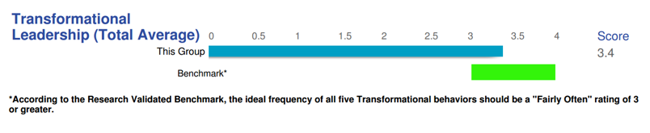
The results…
The MLQ survey went out to 112 current and past DOES presenters
44 responses = 90% confidence level, 10% margin of error (50% ND)
Notes:
Overall our sample of 30 responses from the presenters at DOES supports our hypothesis… the green is the range you would expect for transformational leaders, and our group was right in the middle of the target.

Slide 22
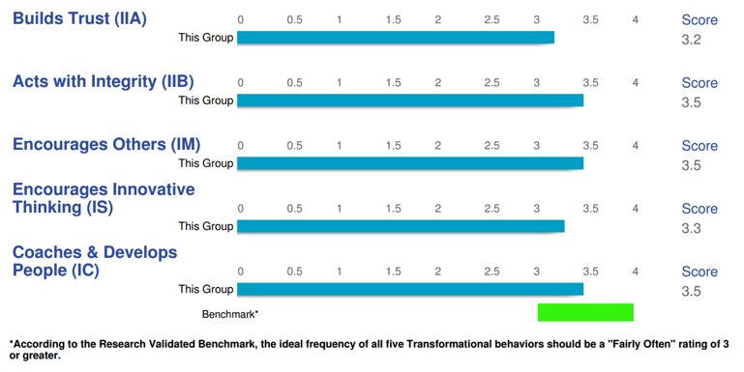
The results…
Notes:
This shows you the breakdown by the individual behaviors within transformational leadership…

Slide 23
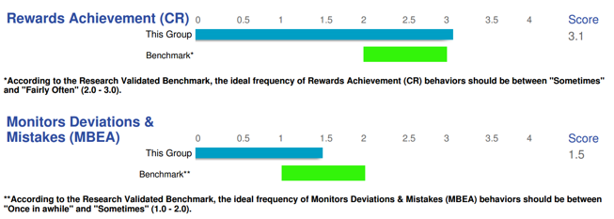
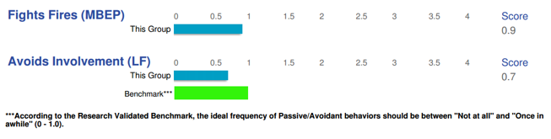
The results…
Transactional Leadership
Passive/Avoidant Behaviors
Notes:
The same survey also tested two other sets of leadership behaviors… transactional and passive/avoidant. We would expect transformational leaders to score lower on these questions as shown by the green indicators. Again, our sample group scored right where we would expect transformational leaders to score.

Slide 24
Here’s what we’ve learned…
Organizational change is hard and prone to failure, especially when it leads to altering the culture
Lean-Agile and DevOps adoption frequently involves organizational and cultural change
Knowledge workers involved in DevOps adoption are working hard and want to do well… the challenges are with the system
Leaders are the only ones who can ultimately change the system, and how they lead through that change can have a direct influence on successful organizational change outcomes
Transformational Leadership behaviors by Lean-Agile Leaders can have a positive influence on the factors that contribute to successful organizational change
Anyone can learn to be a transformational leader!
DOES presenters from the last three conferences demonstrated strong transformational leadership behaviors in the MLQ survey conducted leading up to this conference
Notes:
So here’s a quick review of what we’

Slide 25
Bibliography
Avolio, B.J. and Bass, B.M. (1994). Evaluate the impact of transformational leadership training at individual, group, organizational and community levels. Final Report to the W.K. Kellogg Foundation, Binghamton University, Binghamton, NY.
Avolio, B. J. & Bass, B. M. (2004). Multifactor Leadership Questionnaire. Manual and sampler set. (3rd ed.). Redwood City, CA: Mind Garden.
Bass, B.M. (1990). From transactional to transformational leadership: Learning to share the vision. Organizational Dynamics, (Winter), 19-31.
Bass, B.M. (1998), Transformational leadership: Industrial, military, and educational impact. Mahwah, NJ: Lawrence Erlbaum Associates.
Bass, B. M., Avolio, B. J., Jung, D. I., & Berson, Y. (2003). Predicting unit performance by assessing transformational and transactional leadership. Journal of Applied Psychology, 88(2), 207-218.
Bass, B. M., & Riggio, R. E. (2006). Transformational leadership. Mahwah, NJ: Erlbaum.
Burke, W. W. (2011). A perspective on the field of organization development and change: The Zeigarnik effect. Journal of Applied Behavioral Science, 47(2), 143- 167.
Cândido, C. J.F., & S.P. Santos. (2015). Strategy implementation: What is the failure rate? Journal of Management & Organization, 21(2), 237-262.
Carter, M. Z., Armenakis, A. A., Feild, H. S., & Mossholder, K. W. (2013). Transformational leadership, relationship quality, and employee performance during continuous incremental organizational change. Journal of Organizational Behavior, 34(7), 942-958.
Decker, P., Durand, R., Mayfield, C. O., McCormack, C., Skinner, D., & Perdue, G. (2012). Predicting implementation failure in organization change. Journal of Organizational Culture, Communications & Conflict, 16(2), 39-59.
Deming, W.E. (2000). Out of the crisis (reprint). Cambridge, MA: The MIT Press.
Dvir, T., Eden, D., Avolio, B.J. and Shamir, B. (2002). Impact of transformational leadership on follower development and performance: A field experiment. Academy of Management Journal, 45(4), 735-744.
Edelman, D., Marston, N., & Willmott, P. (2015, October). How to scale your own digital disruption [Web log post]. McKinsey & Company.
Notes:
For those who are curious and want to dig into the resources cited in this presentation, I’ve also included the bibliography for your research enjoyment!

Slide 26
Bibliography
Herold, Fedor, Caldwell, & Liu. (2008). The effects of transformational and change leadership on employees’ commitment to a change: A multi-level study. Journal of Applied Psychology, 93(2), 346-357.
Irshad, R., & Hashmi, M. S. (2014). How transformational leadership is related to organizational citizenship behavior? The mediating role of emotional intelligence. Pakistan Journal of Commerce & Social Sciences, 8(2), 413-425.
Kotter, J. P. (1996). Leading change. Boston, MA: Harvard Business School Press.
Nemanich, L. A., & Keller, R. T. (2007). Transformational leadership in an acquisition: A field study of employees. Leadership Quarterly, 18(1), 49-68.
Novellino, T. (2015, June 4). Don’t get cozy, Fortune 500: It’s do-or-die time for digital disruption [Web log post]. New York Business Journal.
Parry, K. W., & Sinha, P. N. (2005). Researching the trainability of transformational organizational leadership. Human Resource Development International, 8(2), 165-183.
Pawar, B. S., & Eastman, K. K. (1997). The nature and implications of contextual influences on transformational leadership: A conceptual examination. Academy of Management Review, 22, 80–109.
Shin, J., Taylor, M. S., & Seo, M.-G. (2012). Resources for change: The relationships of organizational inducements and psychological resilience to employees’ attitudes and behaviors toward organizational change. Academy of Management Journal, 55, 727-748.
Smith, M. E. (2002). Success rates for different types of organizational change. Performance Improvement, 41(1), 26-33.

Slide 27
Questions?
Notes:
I’m happy to answer any questions you might have about transformational leadership or about SAFe… feel free to stop by the Scaled Agile booth in the exhibit hall… I will be there throughout the conference.

